Slide 1
Software Testing and Quality Assurance
Haiming Liu
liuhaiming@bjtu.edu.cn
School of Software Engineering
Beijing Jiaotong University

Slide 2
Black-box Testing
Random Testing
Equivalence Partitioning
Boundary Value Analysis

Slide 3

Black-box Testing
Test-to-pass and Test-to-fail
Test-to-pass:
assures that the software minimally works,
does not push the capabilities of the software,
applies simple and straightforward test cases,
does not try to “break” the program.
Test-to-fail:
designing and running test cases with the sole purpose of breaking the software.
strategically chosen test cases to probe for common weaknesses in the software.
Notes:
通过性测试和失效性测试
通过性测试：
确保软件最低限度地工作，
不能提升软件的功能，
应用简单明了的测试用例
，不要试图“破坏”程序。
测试失败：
设计和运行测试用例的唯一目的就是破坏软件。
策略性地选择测试用例来探测软件中的常见弱点。

Slide 4
Black-box Testing
Test Data and Test Cases
Test data: Inputs which have been devised to test the system.
Test cases: Inputs to test the system and the predicted outputs from these inputs if the system operates according to its specification.
Notes:
测试数据：为测试系统而设计的输入。
测试用例：用于测试系统的输入，如果系统按照其规范运行，则来自这些输入的预测输出。

Slide 5
Black-box Testing
Input causing anomalous behavior
Input test data
I
System
Output which reveal the presence of defects
Output test results
O

Slide 6
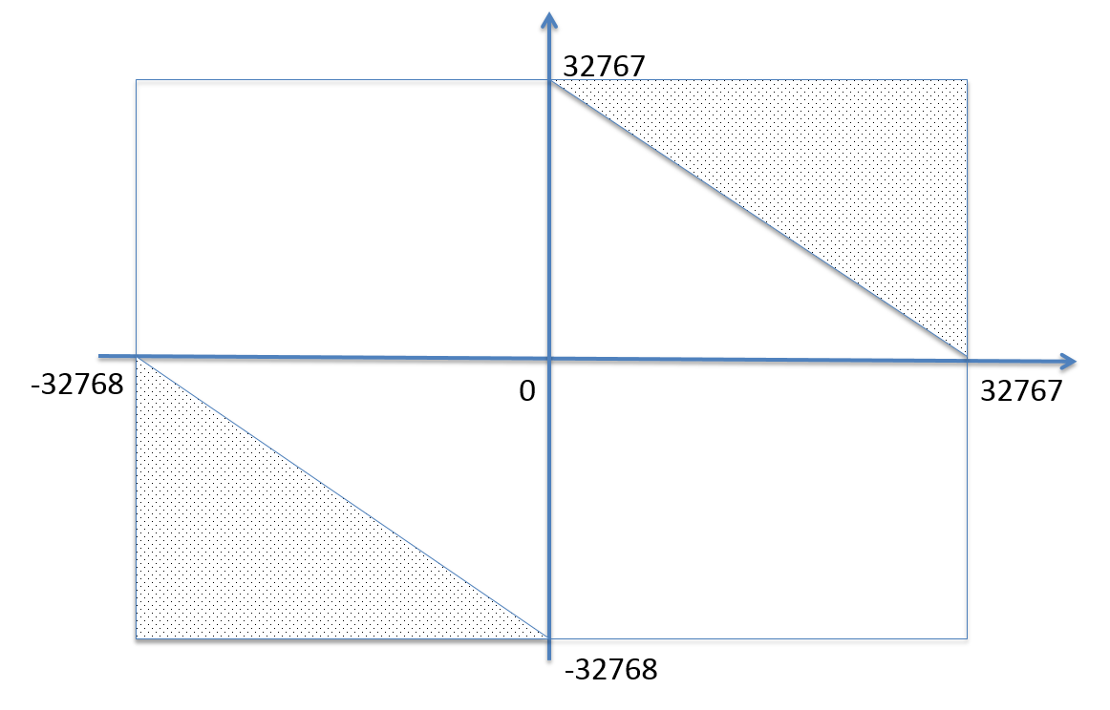
Random Testing(RT)
Test cases are generated purely at random
Input domain must be known
Pick random points within input domain
Automation
int Add(const int &a, const int &b)
{
return a+b;
}
16 bit
Notes:
测试用例是完全随机生成的
输入域必须是已知的
在输入域内选取随机点
自动化

Slide 7
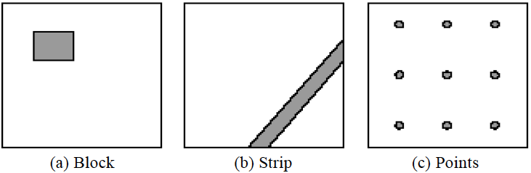
Random Testing
Typical patterns of failure-causing regions
A passed test, nearby tests may be passed
A failed test, nearby tests may be failed
So, select test cases far away from others …
Notes:
已经有研究人员发现，能够导致软件出错的分布一般分为：
例如矩形状分布（block），条带状分布(strip)和散点状分布(points)。对于前两者，可以根据测试用例有聚集性的特点提高测试效率。

Slide 8
Adaptive Random Testing(ART)
Random Testing
Notes:
选择测试用例1，若未出错，定义距离d1
​ 寻找下一条测试用例2时，到离测试用例1>d1的地方
​ 若测试用例2依然没有发生错误，定义距离d2
​ 寻找下一条测试用例3时，到离测试用例1 2 >d2的地方
直至发现错误。
自适应随机测试可以有效的提高软件测试的效率，加快我们发现软件的错误的速度。但是也会面临一些问题

Slide 9
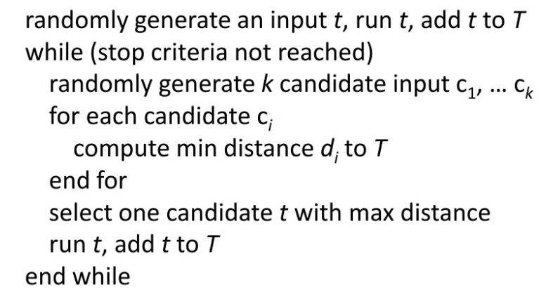
FSCS-ART algorithm
Problem in ART
Distance
Sampling
Notes:
​固定候选集的自适应随机测试算法（FSCS-ART algorithm）：
随机生成第一条测试用例
如果测试终止条件（寻找到一条错误、测试资源耗尽）不满足
随机生成k个候选测试用例
计算这k个候选距离已有测试用例的距离，选择距离最大的一个
运行测试用例，返回2

Slide 10
Anti-Random Testing
Hamming Distance
x ⊕ y= z
10101 ⊕ 00110 = ?
10101 ⊕ 00110 = 3
10101
00110
test1 = 00000000
test2 = 11111111
test3 = 00001111
test4 = 11110000
THM(test2) = 8
THM(test3) = 8
THM(test4) = 16
Notes:
​逆随机测试

Slide 11
Define equivalence partitions - or classes
Equivalence partitioning helps us cut down the number of test cases without adding a great deal of risk.
Normally we look at two areas for testing:
- Data
- Logic flow
There are many guidelines for picking equivalence partitions.
Note: These are guidelines, not hard and fast rules.
Notes:
等价划分可以帮助我们减少测试用例的数量，而不会增加很多风险。等价类划分是指分步骤地把海量或是无限的测试用例缩减的很少，但是过程同样有效。
通常我们看两个区域进行测试：
-数据
-逻辑流程，

Slide 12
Data Testing GUIDELINES FOR CHOOSING EQUIVALENCE CLASSES
Identify boundary conditions - data that is at the edge of the planned operational limits of the software.
For the boundaries, partition input into
- Valid data inside the boundary.
- Data just on the boundary (which may be valid or invalid).
- Invalid data just outside the boundary limits.
Boundary conditions should be identified in the requirements or the specifications.
Notes:
确定边界条件-数据 处于软件计划操作限制边缘的数据。
对于边界，将输入划分为
-边界内的有效数据。
-边界上的数据（可能有效或无效）。
-超出边界限制的无效数据。

Slide 13
Equivalence Partitioning
Idea is to partition the input space into a number of equivalence classes such that one could expect, based on the specification, that every element of a given class would be ‘‘handled’’ (i.e., mapped to
an output) in the same manner
(either correctly or incorrectly),
thus reducing the total number of test cases that must be developed.
Two types of classes are identified:
valid (corresponding to inputs deemed valid from the specification)
invalid (corresponding to inputs deemed erroneous from the specification)
Notes:
等价类划分其思想是将输入空间根据规范划分为若干等价类，这样可以期望给定类的每个元素都以相同的方式“处理”（即映射到输出）（正确或错误），从而减少必须开发的测试用例总数。
因此等价类划分可以分成两种不同的情况：
有效等价类（对应于规范中视为有效的输入）
无效等价类（与规范中被视为错误的输入相对应）

Slide 14
Equivalence Partitioning
Divide all possible inputs into classes (partitions) such that : There is a finite number of input equivalence classes
You may reasonably assume that
The program behaves analogously for inputs in the same class
One test with a representative value from a class is sufficient
If the representative detects a fault, then other class members would detect the same fault
i₁
i₄
i₂
i₃
all inputs
Notes:
将所有可能的输入划分为类（分区），以便：有有限个输入等价类

Slide 15
Equivalence Classes Strategy
Identify input equivalence classes
Based on conditions on inputs/outputs in specification/description: Both valid and invalid input equivalence classes
Based on heuristics and experience :
“input x in [1..10]”
→ classes : x < 1, 1 ≤ x ≤ 10, x > 10
“enumeration A, B, C“
→ classes : A, B, C, not{A,B,C,}
"input integer
→ classes : n not an integer, n < min, min ≤ n < 0, 0 ≤ n ≤ max, n > max
Notes:
识别输入等价类
基于规范/描述中输入/输出的条件：有效和无效的输入等价类
基于启发法和经验：……
枚举
为每个类定义一个/两个测试用例

Slide 16
Equivalence Partitioning Example 1
Partition system inputs into groups (partitions) that should cause
equivalent behaviour, include both valid and invalid inputs.
If input is a 5-digit integer between 10,000 and 99,999,
Equivalence partitions are:
< 10,000 10,000 - 99,999 > 99,999
Notes:
将系统输入划分到组（分区）中，这些组（分区）应引起等效行为，包括有效和无效输入。

Slide 17
Equivalence Partitioning Example 2
Identify (multiple sets of disjoint) equivalence classes for the following program specification fragment.
Individual Income Tax Specification:
If gross pay is no more than ￥36,000, the tax is 3%.
If gross pay is more than ￥36,000, but no more than ￥144,000, the tax is 10%.
If gross pay is more than ￥ 144,000, but no more than ￥300,000, the tax is 20%.
If gross pay is more than ￥ 300,000, but no more than ￥420,000, the tax is 25%.
Notes:
为以下程序规范片段标识（多组不相交的）等价类。
个税：

Slide 18
Equivalence Partitioning
1. If input is a range, one valid and two invalid equivalence classes:
less than range
in range
greater than range
2. If input is a specific value, one valid and two invalid equivalence classes:
less than value
value
greater than value
3. If input is a set of related values, one valid and one invalid class:
not member of set
member of set
4. If input is Boolean, one valid and one invalid class:
nonBoolean
Boolean

Slide 19

主观题
Equivalence Partitioning
10分
Test for 中国大陆手机电话号码:
Input condition | Valid equivalence class | Invalid equivalence class
作答

Slide 20
Equivalence Partitioning Example

Slide 21
主观题
Equivalence Partitioning
10分
Test for 中国大陆家用固定电话号码:
作答

Slide 22

Equivalence Partitioning
Test for ID number（身份证）

Slide 23
主观题
Equivalence Partitioning
10分
Test for ID number（身份证）:
作答

Slide 24
Equivalence Partitioning
Test for ID number（身份证）

Slide 25
Equivalence Partitioning Example 4
We want to design a program
The program reads three integers from an input box
The three integers represent three edges of a triangle
The program will tell you the triangle is scalene, isosceles or equilateral
A
C
B

Slide 26
Black-box Testing
Random Testing
Equivalence Partitioning
Boundary Value Analysis

Slide 27
Black-Box testing - Boundary Value Analysis (BVA)
errors hide in the corner
A technique based on identifying, and generating test cases to explore boundary conditions.
Boundary conditions are an extremely rich source of errors.
Natural language based specifications of boundaries are often ambiguous, as in ‘‘for input values of X between 0 and 40,...’’
May be applied to both input and output conditions.
Also applicable to white box testing.
more errors occur at the boundaries of an input domain than in the “center”
Notes:
错误隐含在角落 errors hide in the corner
边界值分析法是一种基于识别和生成测试用例来探索边界条件的技术。边界值分析法是对等价类划分方法的补充。
因此，测试用例来自等价类的边界。

Slide 28
Types in Boundary
First/last
Min/Max
Star/Finish
Empty/Full
Slower/Faster
Largest/Smallest
Over/Under
Shortest/Longest
… …
Numeric
Character
Position
Quantity
Speed
Location
Size

Slide 29
Examples of possible boundary conditions
Limits on input data – size, type
Limits on output data- size, type
Look for limits such as
First-1/Last+1
Start-1/Finish+1
Min-1/max+1
Less than empty/ more than full
just Over/Just Under
etc.
Don’t hesitate to choose data outside boundaries, even when it seems absurd.
Notes:
测试边界
不要犹豫选择边界之外的数据，即使它看起来很荒谬。

Slide 30
Boundary Values
Based on experience / heuristics :
Testing boundary conditions of eq. classes is more effective i.e. values directly on, above, and beneath edges of classes
Choose input boundary values as tests in input classes instead of, or additional to arbitrary values
Choose also inputs that invoke output boundary values ( values on the boundary of output classes )
Example strategy as extension of equivalence partitioning:
choose one (n) arbitrary value(s) in each eq. class
choose values exactly on lower /upper boundaries of eq. class
choose values immediately below /above each boundary ( if applicable )
Notes:
基于经验/启发：
测试等式类的边界条件更有效，即直接在类的边上、边上和边下的值
选择输入边界值作为输入类中的测试，而不是作为任意值的附加值
同时选择调用输出边界值（输出类边界上的值）的输入
等价划分扩展的示例策略：
在每个等式类中选择一（n）个任意值精确
选择等式类的上下限值
选择每个边界正下方/正上方的值（如果适用）

Slide 31
Guidelines for Identifying Boundary Values
1. If the input range is bounded by a and b, then use a, b, and values just above and just below a and b, respectively.
a
b
2. If the input is a number of values, use the minimum and maximum of the values and values just above and just below them, respectively.
a
b
3. Apply guidelines 1 and 2 to create output values at the minimum and maximum expected values.
4. If data structures have boundaries, test these boundary values and values just above and just below them, respectively.
e.g., for an array of bounds 1 to 10
— test array index equal to 0, 1,2, 9, 10, 11

Slide 32
BVA Example
Test a function for calculation of absolute value of an integer
Valid equivalence classes :
Condition Valid eq. classes Invalid eq. Classes
particular abs < 0, >= 0
Test cases :
class x < 0, arbitrary value: x = -10
class x >= 0, arbitrary value x = 100
classes x < 0, x >= 0, on boundary : x = 0
classes x < 0, x >= 0, below and above: x = -1, x = 1
Notes:
测试函数以计算整数的绝对值
有效等价类：

Slide 33
BVA Example
Test a function which limit user input to positive integer (6-digit)
Test cases :
Class arbitrary value: X1 = 123123
Class arbitrary value: X2 = 12345
Class boundary value: X3 = 999999
Class boundary value: X4 = 1
Class boundary value: X5 = 0
Class invalid value: X6 = -1
Class invalid value: X7 = asdasd
Others?
Class invalid value: X8 = 000123
X9 = asd123
X10 = Empty

Slide 34
BVA Example
If input is a 5-digit integer between 10,000 and 99,999

Slide 35
BVA Example
Individual Income Tax Specification:
If gross pay is no more than ￥36,000, the tax is 3%.
If gross pay is more than ￥36,000, but no more than ￥144,000, the tax is 10%.
If gross pay is more than ￥ 144,000, but no more than ￥300,000, the tax is 20%.
If gross pay is more than ￥ 300,000, but no more than ￥420,000, the tax is 25%.
Notes:
为以下程序规范片段标识（多组不相交的）等价类。
个税：

Slide 36
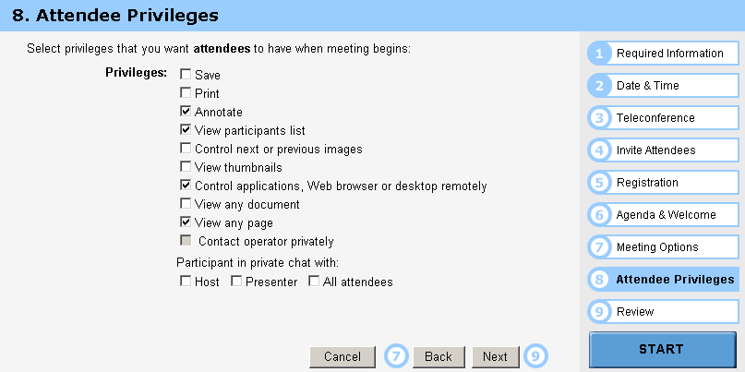
BVA Example

Slide 37
Guidelines for choosing Equivalence classes For Data Testing
Identify sub-boundary conditions or internal boundary conditions
Some limits may not be apparent to the general end user.
To locate some of these, you may need to talk with programmers.
Example: Powers-of-two boundary conditions
Notes:
某些限制对于一般最终用户可能并不明显。
要找到其中一些，您可能需要与程序员交谈。
示例：2的幂 的边界条件

Slide 38
Power-of-Two
Binary: 0 and 1, byte is made up of 8 bits, word is made up of 4 bytes, …
Term | Range or Value
Bit Nibble Byte Word Kilo Mega Giga Tera | 0 or 1 0-15 <Half byte> 0-255 0-4294967295 1024 1048576 1073741824 1099511627776
位
半字节
字节
字
千
兆
吉
太

Slide 39
EXAMPLE: Powers-of-Two
Often a programmer will handle data differently depending upon its size.
Example: Communications software where with limited bandwidth, we try to keep the size of data being transmitted low.
Program transmits 256 commands, but uses only a nibble (4 bits) to encode the 15 most commonly used commands.
Thus, there is an internal boundary between the 4th and 5th bit
Might try transmitting 3, 4, 5 bits in addition to ones determined by the stated boundary conditions of 1 and 8 bits.
Notes:
程序员通常会根据数据的大小来处理不同的数据。
例如：在有限带宽的通信软件中，我们试图保持传输的数据量较小。

Slide 40
An Example: A flight simulator
Assume the user can control the height of the plane, determine what those limits are:
Not specified?
Why not?
Nothing in a computer is infinite!
Try flying
Below ground
In outer space
Through a mountain (or some other object)

Slide 41
ASCII Table
Character | ASCII Value | Character | ASCII Value
Null Space / 0 1 2 9 ： @ A | 0 32 47 48 49 50 57 58 64 65 | B Y Z [ ‘ a b y z { | 66 89 90 91 96 97 98 121 122 123
Notes:
另一个常见的次边界条件是ASCII字符表

Slide 42
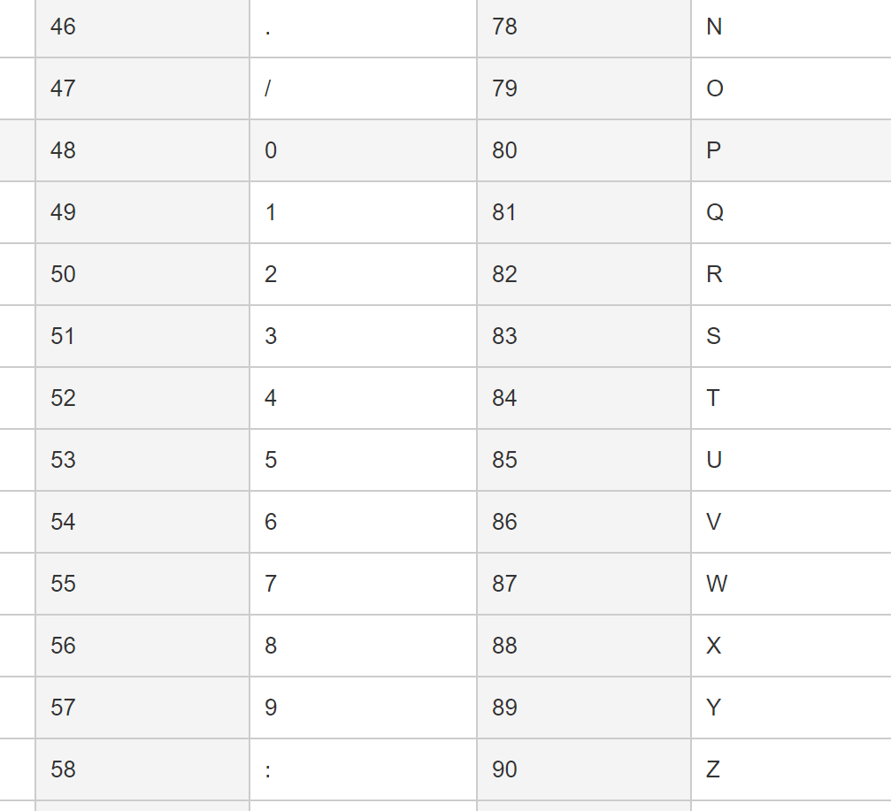
ASCII Encoding Always Produce Sub-Boundary Conditions
The ASCII code is 8 bits.
If numeric digits are to be input,
check just out of range with the ‘/’ and ‘:’
Notes:
ASCII码是8位。
如果要输入数字，
用“/”和“：”检查超出范围

Slide 43
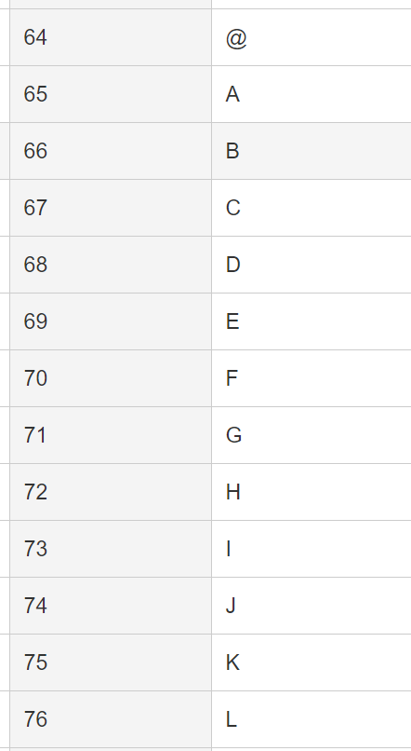
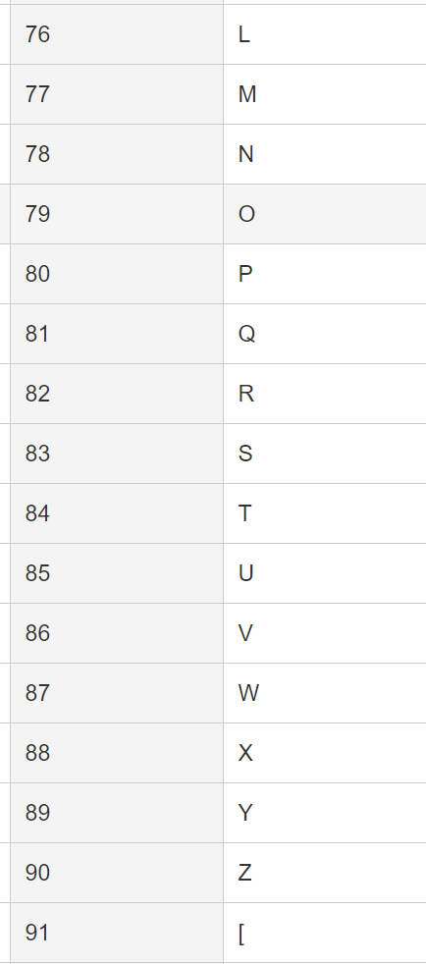
ASCII Encoding Always Produce Sub-Boundary Conditions
The ASCII code is 8 bits.
If capital letters are to be input,
check just out of range with the ‘@’ and ‘[‘
Notes:
ASCII码是8位。
如果要输入数字，
用“/”和“：”检查超出范围
如果要输入大写字母，
用“@”和“[”检查超出范围
如果要输入小写字母，
用前引号和{检查是否超出范围。

Slide 44
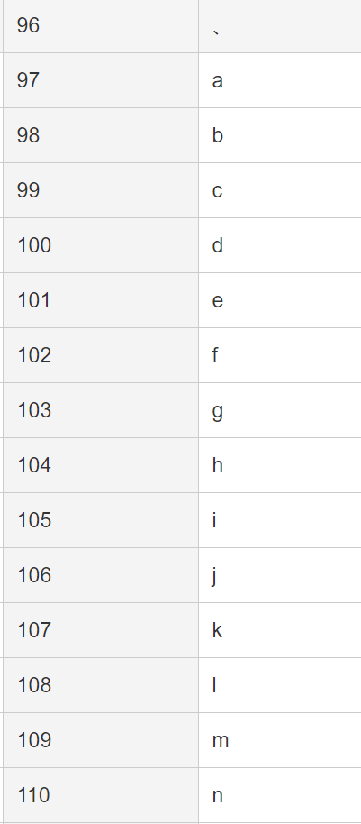
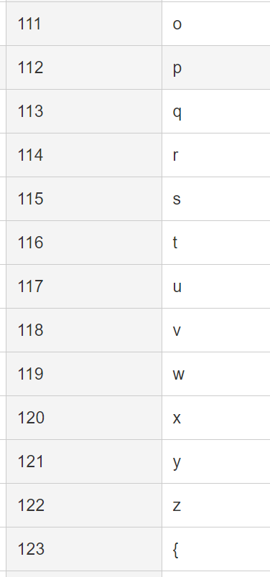
ASCII Encoding Always Produce Sub-Boundary Conditions
The ASCII code is 8 bits.
If lower case letters are to be input,
check just out of range with the forward quote and the ‘{‘.
Notes:
ASCII码是8位。
如果要输入数字，
用“/”和“：”检查超出范围
如果要输入大写字母，
用“@”和“[”检查超出范围
如果要输入小写字母，
用前引号和{检查是否超出范围。

Slide 45
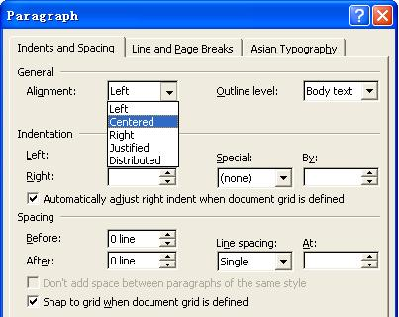
Text-box Field
Default
Empty
Blank
Null
Zero
None

Slide 46
Further Partitioning Possibilities
Check default, empty, blank, null, zero, and no data.
- If nothing is entered, what happens?
- Default set?
- Error message?
- Hung program?
Check invalid, wrong, incorrect, and garbage data.
- Users WILL use the software incorrectly.
- Data loses or crashes are blamed on the software, always --- not the user
- Have fun with this one --- devious, tricky, and nasty are good traits for a tester!
Notes:
进一步划分的可能性

Slide 47
To be continued… See you next week

